Slide 1
#Section7 Cursors & Collections
IT늦공 김부장

Slide 2
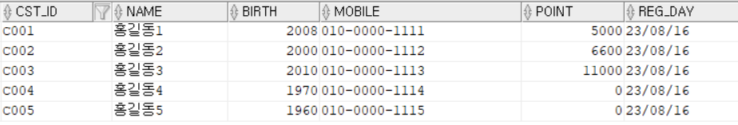
# Cursors & Collections 프롤로그
단일필드 변수
v_name varchar2(20)
v_name cst_info.name%type
전체필드 (ROWTYPE record)
r_cst_info cst_info%rowtype
단일 row 의 값이 아닌
Multi Row 의 값
Type Record (사용자 정의)
Type recname IS Record( cst_id varchar2(20, name cst_info.name%type; )
IT늦공 김부장

Slide 3

# Cursors & Collections 프롤로그
cursor
IT늦공 김부장

Slide 4
# Implicit Cursor (묵시적 커서)
6.2.1 Implicit Cursors
An implicit cursor is a session cursor that is constructed and managed by PL/SQL.
PL/SQL opens an implicit cursor every time you run a SELECT or DML statement.
You cannot control an implicit cursor, but you can get information from its attributes.
묵시적 커서는 PL/SQL에 의해 생성되고 관리되는 세션 커서입니다.
PL/SQL은 SELECT 또는 DML 문을 실행할 때마다 묵시적 커서를 엽니다.
묵시적 커서를 제어할 수는 없지만 해당 속성에서 정보를 얻을 수 있습니다.
SQL%ISOPEN Attribute: Is the Cursor Open?
SQL%FOUND Attribute: Were Any Rows Affected?
SQL%NOTFOUND Attribute: Were No Rows Affected
SQL%ROWCOUNT Attribute: How Many Rows Were Affected?
IT늦공 김부장

Slide 5
# Explicit Cursors (명시적 커서)
6.2.2 Explicit Cursors
An explicit cursor is a session cursor that you construct and manage. You must declare and define an explicit cursor, giving it a name and associating it with a query (typically, the query returns multiple rows). Then you can process the query result set in either of these ways:
Open the explicit cursor (with the OPEN statement), fetch rows from the result set (with the FETCH statement),
and close the explicit cursor (with the CLOSE statement).
Use the explicit cursor in a cursor FOR LOOP statement (see "Processing Query Result Sets With Cursor FOR LOOP Statements".
[Sample]
declare
Cursor cur_cst_info
is select cst_id, name from cst_info;
v_cst_id cst_info.cst_id%type;
v_name cst_info.name%type;
begin
Open cur_cst_info;
Loop
FETCH cur_cst_info Into v_cst_id,v_name ;
Exit When cur_cst_info%NOTFOUND;
dbms_output.put_line(v_cst_id ||'-'||v_name);
End Loop;
Close cur_cst_info;
dbms_output.put_line(chr(10)||chr(13));
End;
[Example 6-24 Cursor Variable Declarations]
DECLARE
TYPE empcurtyp IS REF CURSOR RETURN employees%ROWTYPE; -- strong type
TYPE genericcurtyp IS REF CURSOR; -- weak type
cursor1 empcurtyp; -- strong cursor variable
cursor2 genericcurtyp; -- weak cursor variable
my_cursor SYS_REFCURSOR; -- weak cursor variable
TYPE deptcurtyp IS REF CURSOR RETURN departments%ROWTYPE; -- strong type
dept_cv deptcurtyp; -- strong cursor variable
BEGIN
NULL;
END;
/
IT늦공 김부장

Slide 6
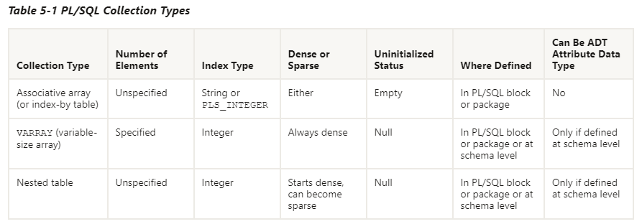
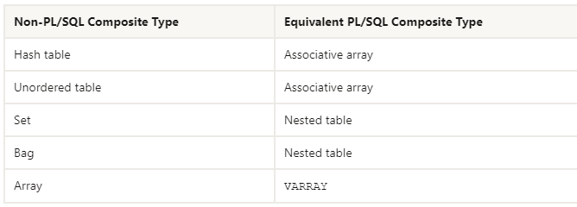
# Collections 개념
Collection = Array ?
Key – Value 로 구성
길이가 정해지는 배열
길이가 고정되지 않은 가변배열
☞ 실제 실습해보면서 이해하기 ~
IT늦공 김부장

Slide 7
# Collections 개념
/* Associative array Sample */
DECLARE
-- Associative array indexed by string:
TYPE Capital IS TABLE OF VARCHAR2(50) -- Associative array type
INDEX BY VARCHAR2(64); -- indexed by string
city_capital Capital; -- Associative array variable
v_index VARCHAR2(64); -- Scalar variable
BEGIN
-- Add elements (key-value pairs) to associative array:
city_capital('한국') := '서울';
city_capital('프랑스') := '파리';
city_capital('영국') := '런던';
DBMS_Output.PUT_LINE(city_capital('한국'));
-- Print associative array:
v_index := city_capital.FIRST; -- Get first element of array
WHILE v_index IS NOT NULL LOOP
DBMS_Output.PUT_LINE('Population of ' || v_index || ' is ' || city_capital(v_index));
v_index := city_capital.NEXT(v_index); -- Get next element of array
END LOOP;
END;
/
/* Varrays (Variable-Size Arrays) Sample */
DECLARE
TYPE Capital IS VARRAY(10) OF VARCHAR2(50); --Varrays (Variable-Size Arrays) type
city_capital Capital := Capital('서울','파리','런던') ; -- Varrays variable
BEGIN
FOR i IN 1..city_capital.count LOOP
DBMS_OUTPUT.PUT_LINE(city_capital(i));
END LOOP;
END;
/
/* Nested Tables Sample */
DECLARE
TYPE Capital IS TABLE OF VARCHAR2(20); -- nested table type
-- nested table variable initialized with constructor:
city_capital Capital := Capital('서울','파리','런던');
Begin
FOR i IN city_capital.FIRST .. city_capital.LAST LOOP -- For first to last element
DBMS_OUTPUT.PUT_LINE(city_capital(i));
END LOOP;
DBMS_OUTPUT.PUT_LINE('---');
END;
/
IT늦공 김부장

Slide 8
# Collections – 객체(Table , Record, Cursor ..) 사용
단순 문자열등 사용
Associative array
TYPE Capital IS TABLE OF VARCHAR2(50)
INDEX BY VARCHAR2(64); city_capital Capital;
city_capital('한국') := '서울';
city_capital('프랑스') := '파리';
city_capital('영국') := '런던';
Varrays
TYPE Capital IS VARRAY(10) OF VARCHAR2(50);
city_capital Capital := Capital('서울','파리','런던') ;
Nested Tables
TYPE Capital IS TABLE OF VARCHAR2(20);
-- nested table variable initialized with constructor:
city_capital Capital := Capital('서울','파리','런던');
배열에
객체 넣기
Table or Record 활용
IT늦공 김부장

Slide 9
# Collections - BULK COLLECT INTO / FORALL
Collections 확장 – DB Table 입력
TYPE Capital IS TABLE OF VARCHAR2(20); -- varchar2(20) 문자열
TYPE Capital IS TABLE OF CST_INFO%ROWTYPE; -- CST_INFO Table
[Sample 2]
DECLARE
TYPE nl_cst_info IS TABLE OF cst_info%rowtype;
l_cst_info nl_cst_info := nl_cst_info() ; -- 초기화
BEGIN
SELECT *
BULK COLLECT INTO l_cst_info
FrOM cst_info;
DBMS_OUTPUT.put_line (chr(10)||chr(13));
FOR indx IN l_cst_info.first .. l_cst_info.COUNT
LOOP
insert into cst_info2(cst_id, name, birth, mobile, point,reg_day)
values (l_cst_info(indx).cst_id, l_cst_info(indx).name, l_cst_info(indx).birth,
l_cst_info(indx).mobile, l_cst_info(indx).point, l_cst_info(indx).reg_day);
END LOOP;
END;
[Sample 1]
DECLARE
TYPE nl_cst_info IS TABLE OF cst_info%rowtype;
l_cst_info nl_cst_info := nl_cst_info() ; -- 초기화
BEGIN
For fc In (SELECT * FrOM cst_info)
Loop
l_cst_info.EXTEND;
l_cst_info(l_cst_info.LAST).cst_id := fc.cst_id;
l_cst_info(l_cst_info.LAST).name := fc.name;
l_cst_info(l_cst_info.LAST).birth := fc.birth;
dbms_output.put_line(fc.cst_id);
End Loop;
DBMS_OUTPUT.put_line (chr(10)||chr(13));
FOR indx IN l_cst_info.first .. l_cst_info.COUNT
LOOP
DBMS_OUTPUT.put_line (l_cst_info (indx).cst_id);
DBMS_OUTPUT.put_line (l_cst_info (indx).name);
DBMS_OUTPUT.put_line (chr(10)||chr(13));
END LOOP;
END;
대량의 데이터를
처리할 경우
BULK COLLECT INTO FORALL 사용
FORALL indx IN l_cst_info.first .. l_cst_info.COUNT
insert into cst_info2(cst_id, name, birth, mobile, point,reg_day)
values (l_cst_info(indx).cst_id, l_cst_info(indx).name, l_cst_info(indx).birth,
l_cst_info(indx).mobile, l_cst_info(indx).point, l_cst_info(indx).reg_day);
IT늦공 김부장

Slide 10
# Collections – 객체(Table , Record, Cursor ..) 사용의 배경
Why ?
DECLARE
BEGIN
For fc In (SELECT * FROM cst_info)
Loop
insert into cst_info2(cst_id, name, birth, mobile, point,reg_day)
values (fc.cst_id, fc.name, fc.birth, fc.mobile, fc.point, fc.reg_day);
End Loop;
END;
PL/SQL
sql
SQL 실행영역
Oracle Database 개발자가 작성하는 거의 모든 프로그램에는 PL/SQL 및 SQL 문이
모두 포함되어 있습니다. PL/SQL 문은 PL/SQL 문 실행기에 의해 실행됩니다.
SQL문은 SQL문 실행 프로그램에 의해 실행됩니다.
PL/SQL 런타임 엔진은 SQL 문을 발견하면 중지하고 SQL 문을 SQL 엔진으로 전달합니다.
SQL 엔진은 SQL 문을 실행하고 정보를 다시 PL/SQL 엔진으로 반환합니다.
이러한 제어 전송을 컨텍스트 스위치라고 하며 이러한 스위치 각각은
프로그램의 전체 성능을 저하시키는 오버헤드를 발생시킵니다.
☞ cst_info 의 개수만큼 context switch 발생 만일 cst_info 의 개수가 10만개라면 10만번의 Switch 발생
https://livesql.oracle.com/apex/livesql/file/tutorial_IEHP37S6LTWIIDQIR436SJ59L.html
IT늦공 김부장

Slide 11
# Collections - BULK COLLECT INTO - Limit
[ LIMIT Sample ]
DECLARE
TYPE nl_cst_info IS TABLE OF cst_info%rowtype;
l_cst_info nl_cst_info := nl_cst_info() ; -- 초기화
my_cursor SYS_REFCURSOR; -- weak cursor variable
BEGIN
Open my_cursor For select * from cst_info;
Loop
FETCH my_cursor BULK COLLECT INTO l_cst_info LIMIT 2;
FORALL indx IN l_cst_info.first .. l_cst_info.COUNT
insert into cst_info2(cst_id, name, birth, mobile, point,reg_day)
values (l_cst_info(indx).cst_id, l_cst_info(indx).name, l_cst_info(indx).birth,
l_cst_info(indx).mobile, l_cst_info(indx).point, l_cst_info(indx).reg_day);
EXIT WHEN my_cursor%NOTFOUND;
End Loop;
Close my_cursor;
END;
Array 객체의 사이즈가 커질수록
메모리의 부담이 증가
Solution -> LIMIT
IT늦공 김부장

